Slide 1
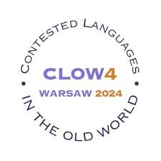

Romanian in Serbia: From Contested Varieties to Standard Languages
Annemarie sorescu-marinković
Institute for balkan studies
Serbian academy of sciences and arts

Slide 2
Outline
Language status, policy and planning of three Romanian varieties spoken in Serbia – Vojvodina Romanian, Vlach and Bayash Romanian.
Vojvodina: Romanian is an official, minority language
Eastern Serbia: the Romanian variety is standardized as a separate language
Bayash Romanian: thrives only as a spoken language
What stigmatizing a community and contesting its language does in the long run to its speakers

Slide 3
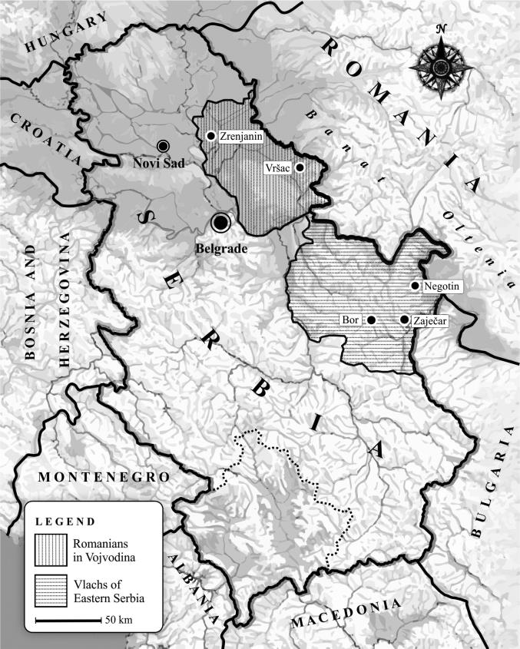
Romanian varieties in Serbia
Vojvodina and Eastern Serbia: a contiguous region
The presence in Serbia of two different communities speaking two varieties of Romanian is the result of different historical events – difference in their treatment by the Serbian outgroup
Bayash – scattered all over the country

Slide 4
Romanian in Vojvodina
Part of the Austro-Hungarian Empire.
Romanians: regular colonizations and migrations within the empire.
After WWI - Kingdom of Serbs, Croats and Slovenes.
The first Census in Yugoslavia to include Vojvodina (1948): 63,130 Romanians.
2022 Census: 23.044 Romanians.
Members of the community are bilingual.
Official languages of the Autonomous Province Vojvodina: Croatian, Hungarian, Romanian, Rusyn, Serbian and Slovak.
Romanian is used in the legislative and executive bodies, in church and media.
Education in Romanian: primary, secondary and partially tertiary level.
Standard Romanian – local Romanian variety.

Slide 5
Vlach in Eastern Serbia
Part of Serbia since it was granted autonomy within the Ottoman Empire in 1830.
Spontaneous migrations in search of a better life, in the 18th and 19th centuries.
A previous layer of Romanized population?
Census data: huge differences.
The members of the community display multiple, contextual, simultaneous identities.
They identify themselves as Romanians or Vlachs, and are always identified as Vlachs by the outgroup.
Researchers claim Vlach has a low prestige both within the out-group and in-group.
Vlaški – rumânjeșće
Year | Vlach mother tongue | Vlach ethnicity
1953 | 198,861 | 28,047
1971 | 139,902 | 14,724
1981 | 129,613 | 25,596
1991 | 71,534 | 17,804
2002 | 54,818 | 40,054
2011 | 43,095 | 35,330
2022 | 23,216 | 21,013

Slide 6
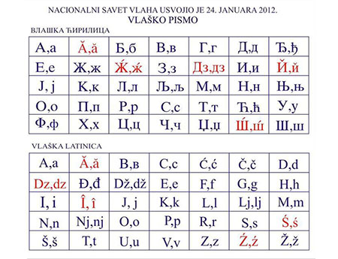
Vlach in Eastern Serbia
Vlach: restricted to the family domain.
Intense assimilation since 1950s.
Bilingualism
2012: spelling system
2013: optional subject “Vlach speech with elements of national culture”
Used in the media and on the Internet.
Language planning measures taken by the engaged members of the community.
2015: standardization of the Vlach language - fiercely contested by Romanian linguists and by members of the community.
Vlach grammar, dictionaries, school books, translations and an incipient literature.
2023: a second standardization

Slide 7
Bayash Romanian
Scattered all over Serbia
Different names: Bayash, Rudari, Romanian Gypsies, Karavlasi
Mother tongue: Romanian varieties with different dialectological bases; considered Roma by the majority population
18th and 19th century, after the abolition of slavery in Romania
“Our language” – “Our People”
Bayash diaspora
Their language has no status in Serbia, unlike Croatia or Hungary
Contested language – contested identity

Slide 8
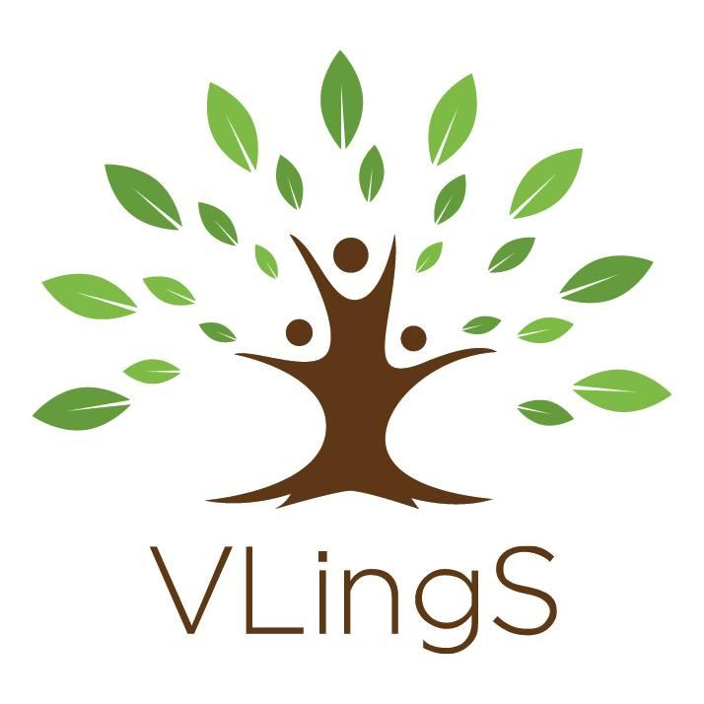
Contesting languages
Researchers claim that Vlach has a low prestige.
Project “Vulnerable Languages and Linguistic Varieties in Serbia” (www.vlings.rs)
Vlach: one of the eight linguistic varieties we focus on (Aromanian, Banat Bulgarian, Bayash Romanian, Ladino, Megleno-Romanian, Romani, Vojvodina Rusyn)
160 interviewees from the Vlach community.
Sociolinguistic questionnaire - 150 questions
“Language attitudes” section:
Has anybody ever forbidden you to speak your language? 9% yes
How do you feel when you speak your language in the presence of Serbs? 23% negative feelings
Do you think your language is important? 88% yes
Do you think your language should be transmitted to younger generations? 86% yes

Slide 9
Contesting languages
What do you think is the most important thing which would help revitalize your language? Not to introduce it in schools.
The reduced prestige of the language within the community might be the result of the long assimilation process, contempt and stigmatization from the majority population, and contesting and forbidding them to speak their language.

