Slide 1


Navigating Vulnerability: Language Attitudes through an Intersectional Lens
Annemarie Sorescu-Marinković dušan vlajić
Institute for Balkan Studies, Serbian Academy of Sciences and Arts
Faculty of Philosophy, University of Niš

Slide 2
objectives
1) to assess the attitudes of speakers of vulnerable languages towards the maintenance and revitalization of their languages
2) to determine whether there is a statistically significant correlation of aforementioned attitudes with specific demographic factors

Slide 3

project
Vulnerable Languages and Linguistic Varieties in Serbia (VLingS), 2022-2024, financed by the Science Fund of Republic of Serbia (www.vlings.rs)
The project aims at providing a more accurate assessment of the degree of vulnerability of languages and linguistic varieties in Serbia.
Based on data offered by Serbian population censuses, the UNESCO Atlas of the World’s Languages in Danger and CEL, but also by unofficial estimates and the direct experience and expertise of the project members, it encompasses the following languages:
Aromanian
Banat Bulgarian
Vojvodina Rusyn (Ruthenian)
Judezmo (Ladino)
Romani (Vlax and Balkan varieties)
Megleno-Romanian
Vlach
Bayash Romanian

Slide 4
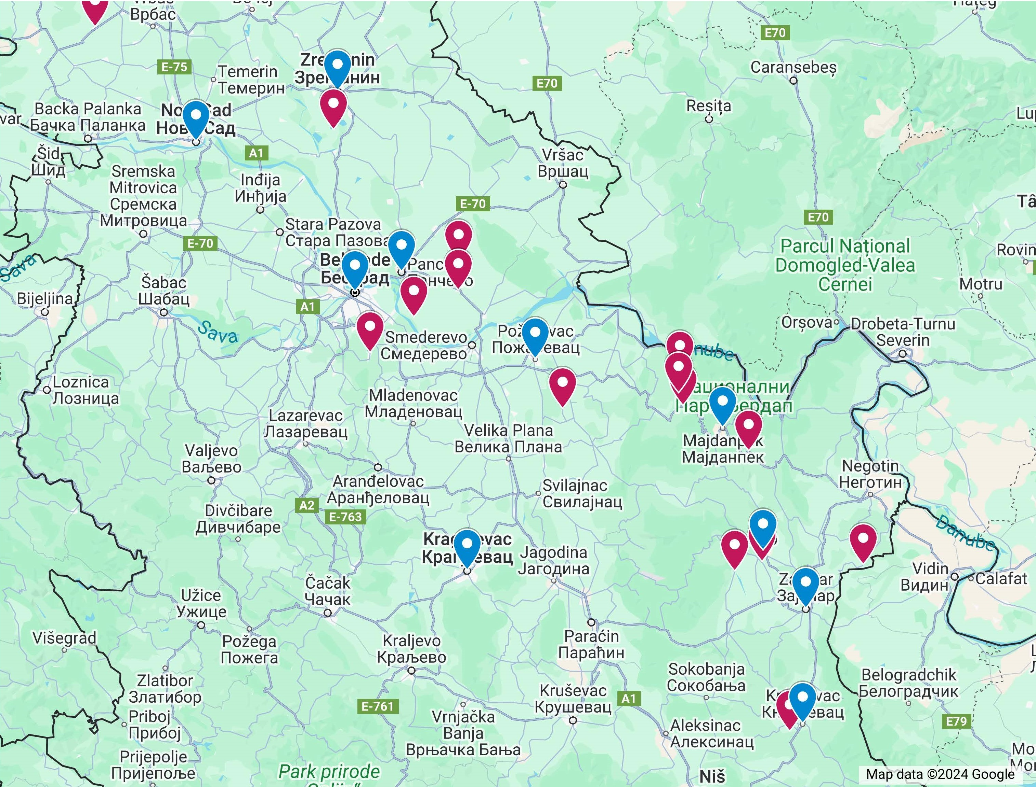
Pilot fieldwork research: 2022
27 places in Serbia: 33.3% rural, 66.7% urban
158 interviewees: 57.3% women, 42.7% men
4 generations: 1 (18–29, 14.6%), 2 (30–44, 28.7%), 3 (45–59, 27.4%), 4 (60+, 29.3%)
Education: no education (7.1%), unfinished elementary school (10.3%), elementary school (17.9%), vocational school (7.7%), high school (18.6%), college (7.7%), university (23.1%), postgraduate (6.4%), other (1.3%)
Language | ROM | VLA | RUS | BUG | BRO | ARO | MEG | LAD | SER | SER + TARGET
Freq | 58 | 41 | 29 | 8 | 5 | 5 | 1 | 1 | 5 | 5
% | 36.7 | 25.9 | 18.4 | 5.1 | 3.2 | 3.2 | 0.6 | 0.6 | 3.2 | 3.2

Slide 5
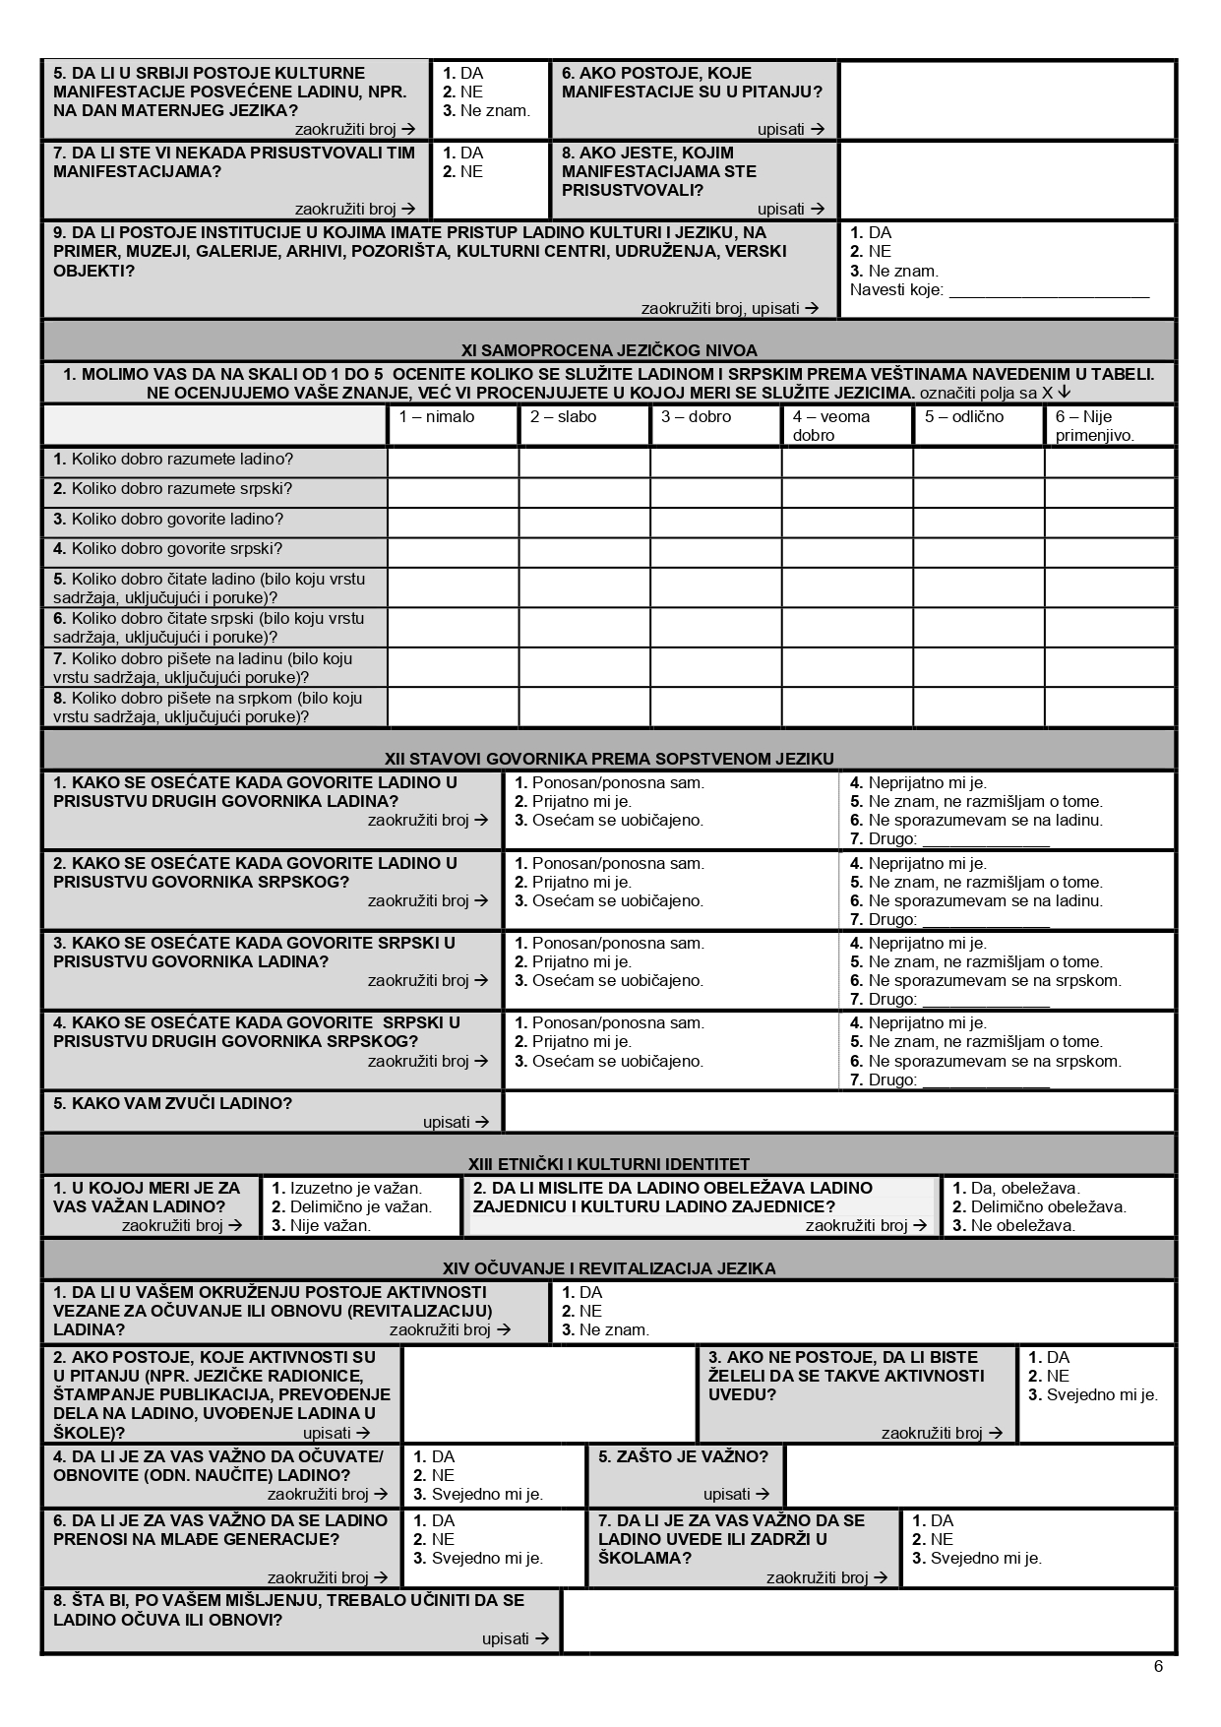
VLingS Questionnaire 0.0
The main research instrument during the first phase of the project.
The pilot questionnaire is not an adaptation of any existing sociolinguistic questionnaire.
Questions are original and were created by the members of the project.
16 sections: 190 questions and subquestions that elicit information based on the interviewees’ personal experience with the languages encompassed by the project
Administered orally, in face-to-face surveys, in Serbian, to allow for the uniformity of the methodology in fieldwork research.

Slide 6
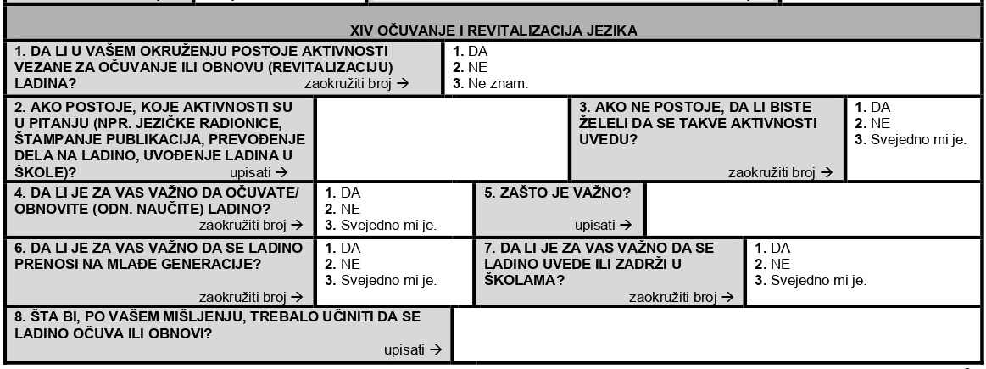
XIV. Language preservation and revitalization
4. Is it important for you to maintain/revitalize (learn) your language?
6. Is it important for you to transmit your language to the young generation?
7. Is it important for you to introduce or keep your language in school?

Slide 7
DESCRIPTIVE STATISTICS
Is it important for you to maintain/revitalize (learn) your language?
 | YES | NO | I DON’T CARE
frequencies | 142 | 2 | 13
% | 89.9 | 1.3 | 8.2
Is it important for you to transmit your language to the young generation?
 | YES | NO | I DON’T CARE
frequencies | 139 | 2 | 15
% | 88 | 1.3 | 9.5

Slide 8
Is it important for you to introduce or keep your language in school?
 | YES | NO | I DON’T CARE
frequencies | 109 | 22 | 22
% | 69 | 13.9 | 13.9
Gender
 | MALE | FEMALE
frequencies | 67 | 90
% | 42.4 | 57

Slide 9
Nationality
 | Serbian | Romanian | Ruthenian | Roma | Bulgarian | Yugoslav | Other | Vlach | Aromanian
frequencies | 28 | 1 | 27 | 58 | 4 | 1 | 13 | 19 | 3
% | 17.7 | 0.6 | 17.1 | 36.7 | 2.5 | 0.6 | 8.2 | 12.0 | 1.9

Slide 10
Education Level
 | No school | Incomplete primary | Primary | Three-year secondary | Four-year secondary/high school | College | University | Postgraduate/doctorate | Other
frequencies | 11 | 16 | 28 | 12 | 29 | 12 | 36 | 10 | 2
% | 7.0 | 10.1 | 17.7 | 7.6 | 18.4 | 7.6 | 22.8 | 6.3 | 1.3

Slide 11
RESULTS
Is it important for you to maintain/revitalize (learn) your language? | GENDER |  | χ2 (2, n = 157) = 3.55, p = .170
 | MALE | FEMALE
YES | 58 | 84
NO | 2 | 0
I DON’T CARE | 7 | 6

Slide 12
... to transmit your language to the young generation? | GENDER |  | χ2 (2, n = 156) = 3.53, p = .171
 | MALE | FEMALE
YES | 57 | 82
NO | 2 | 0
I DON’T CARE | 8 | 7
... to introduce or keep your language in school? | GENDER |  | χ2 (2, n = 153) = 1.53, p = .465
 | MALE | FEMALE
YES | 44 | 65
NO | 12 | 10
I DON’T CARE | 9 | 13

Slide 13
... to maintain/revitalize (learn) your language? | Nationality |  |  |  |  | χ2 (8, n = 145) = 3.597, p = .892
 | Serbian | Ruthenian | Roma | Other | Vlach
YES | 24 | 25 | 51 | 13 | 17
NO | 1 | 0 | 1 | 0 | 0
I DON’T CARE | 3 | 2 | 6 | 0 | 2

Slide 14
...to transmit your language to the young generation? | Nationality |  |  |  |  | χ2 (8, n = 144) = 8.796, p = .360
 | Serbian | Ruthenian | Roma | Other | Vlach
YES | 23 | 26 | 50 | 12 | 16
NO | 0 | 0 | 1 | 1 | 0
I DON’T CARE | 4 | 1 | 7 | 0 | 3

Slide 15
...to introduce or keep your language in school? | Nationality |  |  |  |  | χ2 (8, n = 142) = 29.982, p < .001
 | Serbian | Ruthenian | Roma | Other | Vlach
YES | 22 | 26 | 42 | 7 | 8
NO | 1 | 0 | 10 | 4 | 2
I DON’T CARE | 4 | 1 | 6 | 1 | 8

Slide 16
...maintain/ revitalize (learn) your language? | Education Level |  |  |  |  |  |  |  |  | χ2 (16, n = 156) = 17.819, p = .335
 | No school | Incomplete primary | Primary | Three-year secondary | Four-year secondary/high school | College | University | Postgraduate/doctorate | Other
YES | 10 | 14 | 25 | 10 | 25 | 12 | 34 | 10 | 1
NO | 0 | 1 | 0 | 1 | 0 | 0 | 0 | 0 | 0
I DON’T CARE | 1 | 1 | 3 | 1 | 4 | 0 | 2 | 0 | 1

Slide 17
...transmit your language to the young generation? | Education Level |  |  |  |  |  |  |  |  | χ2 (16, n = 155) = 20.807, p = .186
 | No school | Incomplete primary | Primary | Three-year secondary | Four-year secondary/high school | College | University | Postgraduate/doctorate | Other
YES | 10 | 15 | 24 | 10 | 25 | 12 | 34 | 7 | 1
NO | 0 | 1 | 0 | 0 | 0 | 0 | 0 | 1 | 0
I DON’T MIND | 1 | 0 | 4 | 2 | 4 | 0 | 2 | 1 | 1

Slide 18
...introduce or keep your language in school? | Education Level |  |  |  |  |  |  |  |  | χ2 (16, n = 153) = 16.006, p = .453
 | No school | Incomplete primary | Primary | Three-year secondary | Four-year secondary/high school | College | University | Postgraduate/doctorate | Other
YES | 7 | 11 | 22 | 8 | 22 | 10 | 23 | 6 | 0
NO | 2 | 3 | 5 | 1 | 1 | 1 | 6 | 2 | 1
I DON’T CARE | 2 | 2 | 1 | 3 | 6 | 1 | 6 | 0 | 1

Slide 19
conclusions
The sample in the pilot research was relatively small (158), but the tendencies we noticed here became obvious in the main phase of research (700). Regardless of nationality, gender and level of education, the speakers of vulnerable languages have mostly positive attitudes towards the preservation of their mother tongue.
Most probably speakers of endangered and not endangered languages all over the world have positive attitudes towards the preservation of their mother tongues, as language is an important component of ethnic identity.
Certain nationalities show negative attitudes towards introducing their mother tongue in schools. This might be further connected to other factors, such as the status of the language, standardization, prejudice and low language prestige.

